Slide 1
How to Design, Deliver & Debrief
Enterprise POC’s

Slide 2
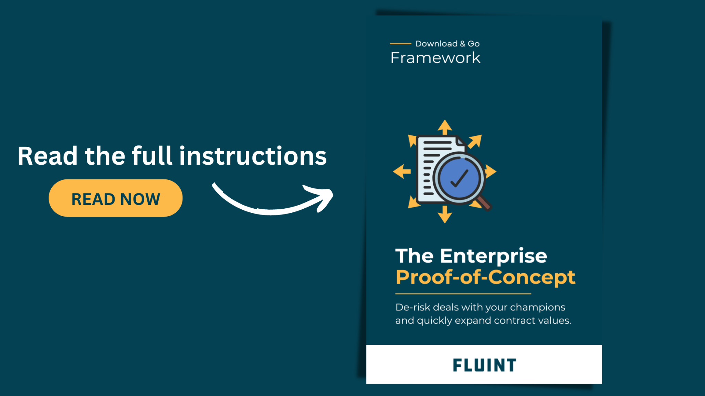
https://www.fluint.io/post/the-hardwired-enterprise-proof-of-concept-framework-land-expand-all-in-one

Slide 3
Step 1: POC Design

Slide 4
Source of Risk
Questions: What’s the most significant, unanswered question that your buyer
has about how you can create new value together? Choose only one question.
Assumptions: What information does your buyer already have about this question? What assumptions are you making? What blind spots do you have?
KEY QUESTION
ASSUMPTIONS
What’s your one question?
What do you need to learn together?
What do we already know?
What blind spots do we have?

Slide 5
Data
Data: Identify the data that would help you answer that single question.
Prediction: What action will you take, and what do you believe will happen?
Fail Condition: What would convince us our belief is false?
Assumptions: What information does your corporate partner already have about this question? What assumptions are you making? What blindspots do you have?
DATA
PREDICTION
FAIL CONDITION
Which data sources will you draw on? How will you access them?
Is the dataset complete? Or will you use a sandbox environment?
Is our prediction falsifiable and specific enough to test?
What outcome would sufficiently invalidate our belief?
What outcome would tell us that we should pivot or adjust our hypothesis, vs. scrap the project altogether?

Slide 6
Plan
Plan: What is the simplest way you can test your belief and develop data to evaluate?
Timing: Is everyone on the same page about what happens, when?
Early Stop Conditions: Determine if and when you’d decide to stop your test early.
PLAN
TIME BOX
EARLY STOP CONDITIONS
How will you structure and execute your test?
Are the steps specific and achievable?
Is the plan timely? Are there enough resources set aside?
Can you gather data or execute actions faster?
What early indicators would tell us our plan isn’t going to work and we should adjust course?

Slide 7
Step 2: Deliver

Slide 8
Results
Go run your experiment and begin executing your plan. Then, record the results:
What happened? Anything unexpected?
What conclusions were you able to draw about your key question?
Should you pivot or persevere as your next step?
Do you need more data, or a new plan?

Slide 9
Step 3: Debrief

Slide 10
Readout Framework
Recommendation: Since we’ve proven < the main risk >, we should proceed with < expansion >.
Context: < problem > has created a significant gap compared to our ideal goal of < payoff >. To address this by < critical event >, we decided the best next step partnering with a < your product category >.
Complication: Yet, < key risk > presented a risk to < unique approach >. So we structured < experiment > to prove we could create < proof point >.
Conclusions: We saw < X — measurable / pass condition >, therefore, we’re confident in continuing to < Y — expansion >.

